Slide 1
MCDB Research Overview
DUS: Douglas.Kankel@yale.edu YSB 111
Research Coordinators:
    Joseph.Wolenski@yale.edu YSB C112
    David.Breslow@yale.edu YSB 216
    Jing.Yan@yale.edu YSB C144

Slide 2
MCDB Research
What qualifies for MCDB Research?
  Bioinformatics
  Computational
  Quantitative Modeling
  Technique & Instrument Development
MCDB Lab vs. Med School Labs

Slide 3
Research Expectations
Time in Lab
  474, 475, 485 10-12 hours/week minimum
  495, 585/595 20 hours/week minimum
Research Reports
  474, 475 12-15 pages
  485 5 pages
  495 5-10 pages
  585 8-10 pages
  595/596 40-100 pages

Slide 4
Research Expectations
MCDB Oral Presentations:
  474, 475 NONE
  485 Spring 2020 (April 17-22, 2020)
  495 Fall 2019 (Dec. 2-6, 2019)
  585 NONE – Committee Meetings each term
  595/596 Fall 2019 (Dec. 2-6, 2019)
            Committee Meetings each term
            Thesis Defense before April 24, 2020
Poster Symposium
  April 24, 2020 2:00-4:00pm in YSB Lobby (Not 474 or 585)

Slide 5
Expectations
Course Goals
  Engaged with research process; defining research questions; determining data/experiments
Grading Rubric
  474 – Pass/Fail Underclassmen and non-majors only
  475 – Senior Requirement only: 1 term for BA (letter grade) or 2 terms Spring of Junior year (letter grade), 8-10 weeks of summer, and Fall of Senior year (letter grade)
  485 & 495 – Fall term receives Satisfactory or Unsatisfactory; Spring term Letter grade that is retroactive for Fall term.
  585 & 595 – Letter grade all terms.
Deadline Dates:
  ALL Contracts & Summary Proposals: Monday, September 9th @ 12:00 noon
  Fall Research Proposal: Friday, December 6th @ 4:00pm.
  Spring Grant Proposal: Friday, April 24th @ 4:00pm.
  Poster Symposium: Friday, April 24th @ 2:00-4:00pm in YSB Lobby.

Slide 6
Expectations
BS/MS Requirements
  Application process
    Deadline: November 1 of Junior Year
    Summary Proposal 5-10 pages
    Committee of 3; 2 need to be from MCDB
    Letter of Recommendation from Research Mentor
    Transcript
    BS/MS Completed Worksheet
    Plan for completing the major
    Yale Graduate School Application
Senior Essay for the BA degree (no credit)
  Critical evaluation of some aspect of the current and pertinent primary biological literature within the realm of biology or may explore relationships of biology to other fields.
  15-20 Pages double-spaced paper due @ 4:00pm on last day of classes

Slide 7
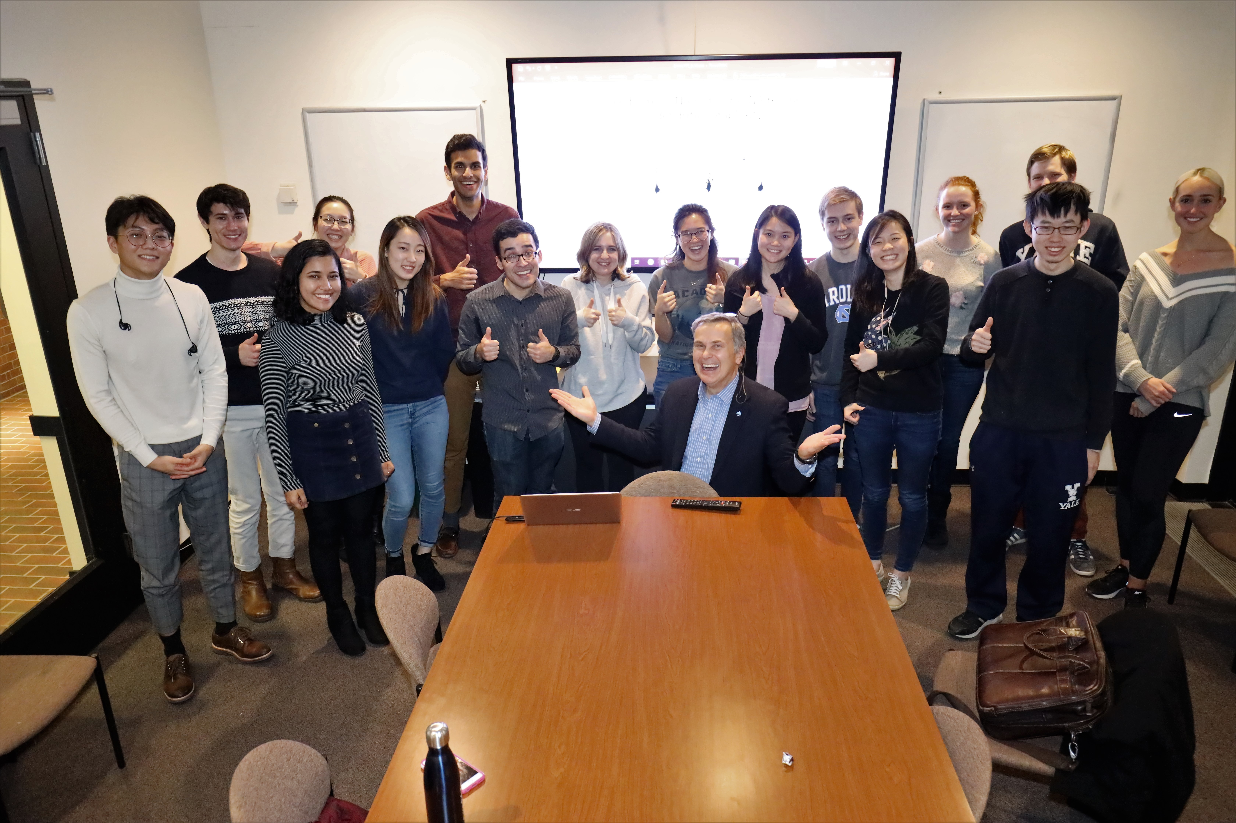
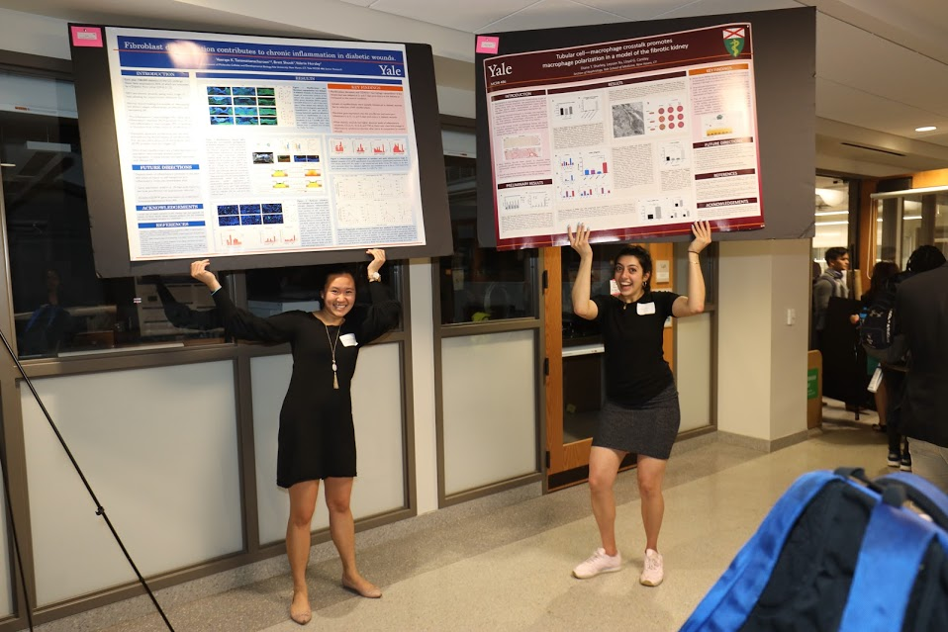
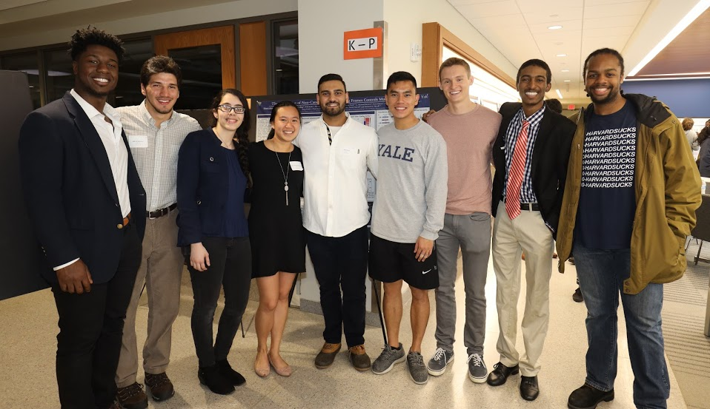
Joseph Wolenski
Joseph.Wolenski@yale.edu KBT 330/YSB C112
How To Find a Laboratory for Independent Research in MCDB

Slide 8
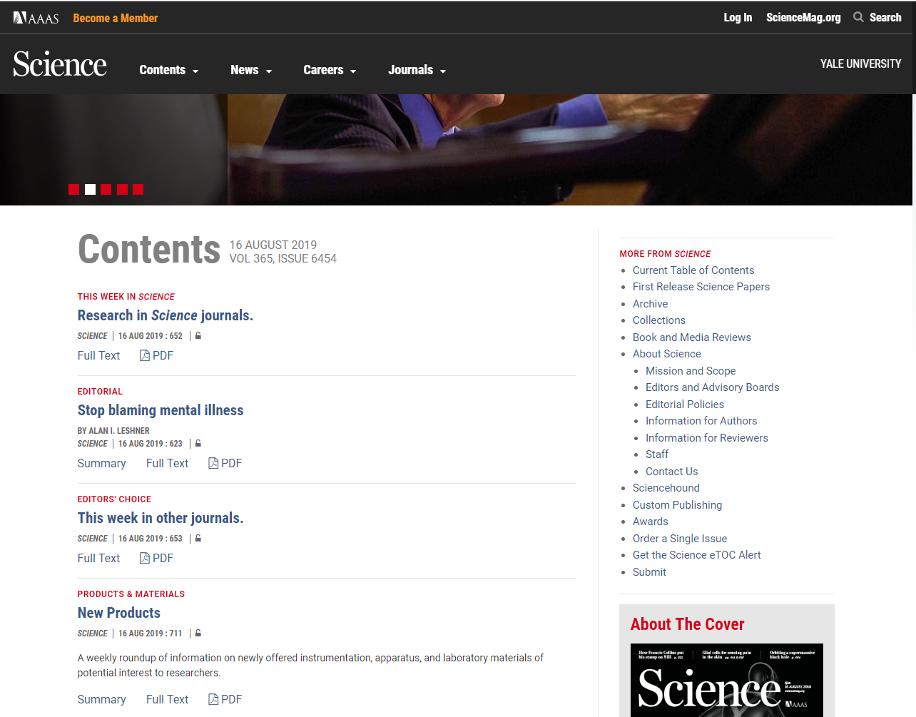
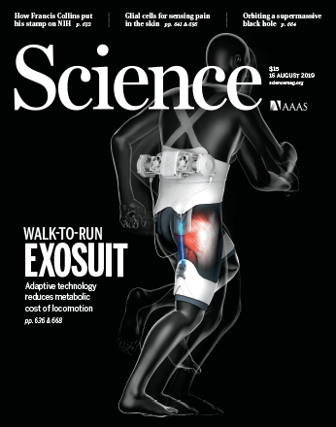
1. Identify you research passion

Slide 9
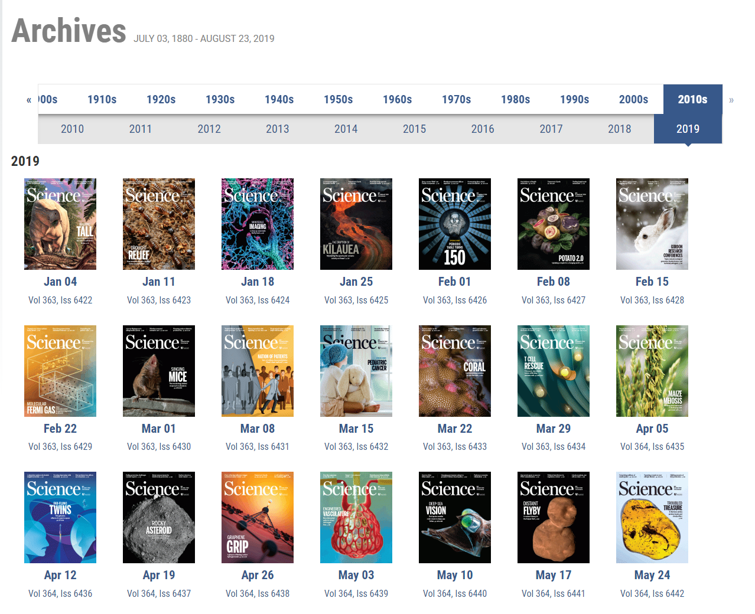

Slide 10
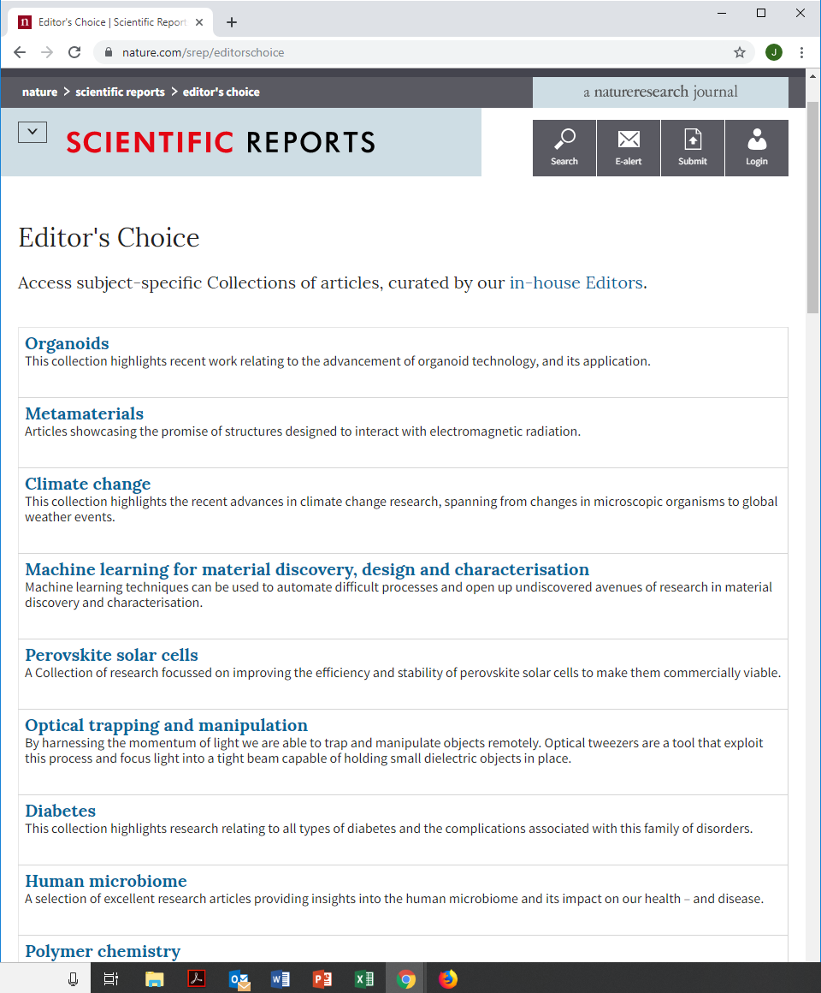
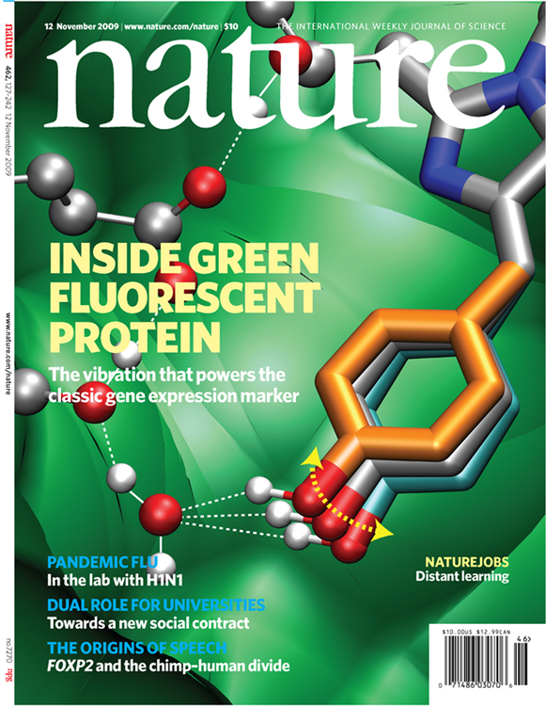

Slide 11


1. In an ideal situation, you will find a research topic that induces a visceral reaction.
You should find yourself saying: “I can’t put this article down,” and “I sincerely want to pursue this area of biomedical research.”

Slide 12
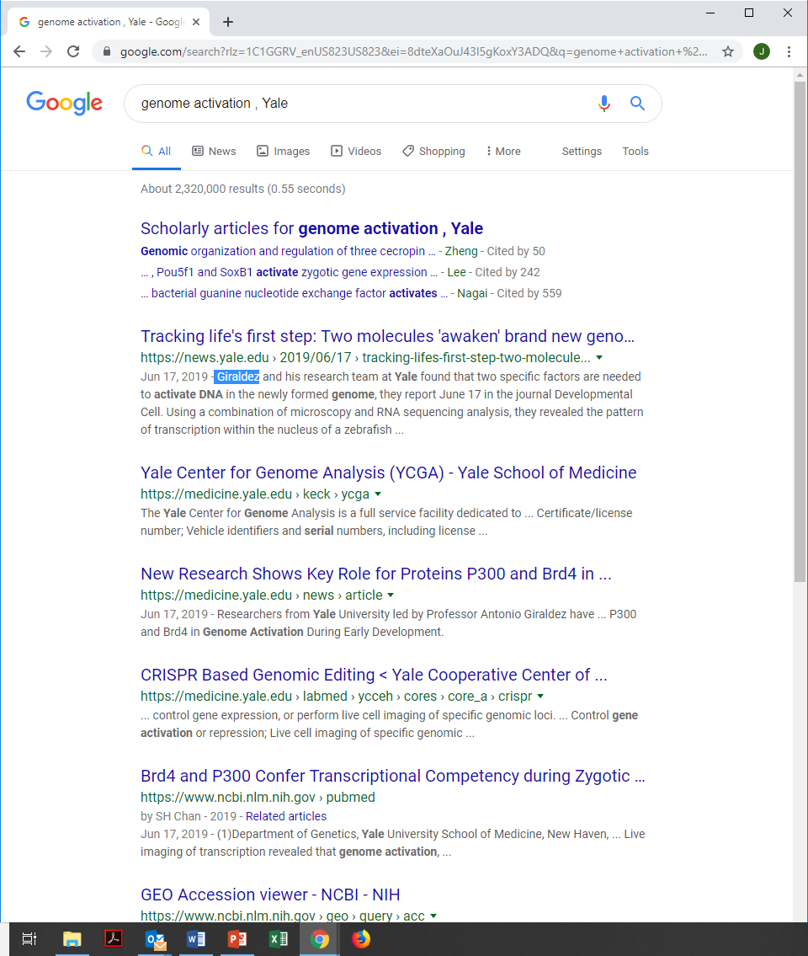
2. Find Someone at Yale that does research compatible with your passion

Slide 13

3. Become knowledgeable on the research topic
Read ~2-3 papers published by the PI of the potential laboratory you want to join. Take notes and write down questions you have on the key take home messages of the papers.

Slide 14
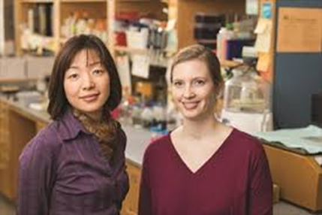
4. Write to the PI and make clear you understand what is happening in the lab.
Write an Email to the PI of the lab indicating:
a) you have read his/her papers,
b) you are interested in the topic,
c) you can make a contribution to the lab.
Don't be discouraged if you don't receive an immediate response. If you don’t hear a response in 3-4 days, send a follow-up email that emphasize your scientific acumen and continued interest.

Slide 15
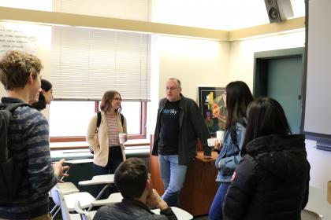
5. Meet with your potential mentor: discuss a research plan and write up a proposal for your MCDB class (MCDB 475, 485, 495).

Slide 16
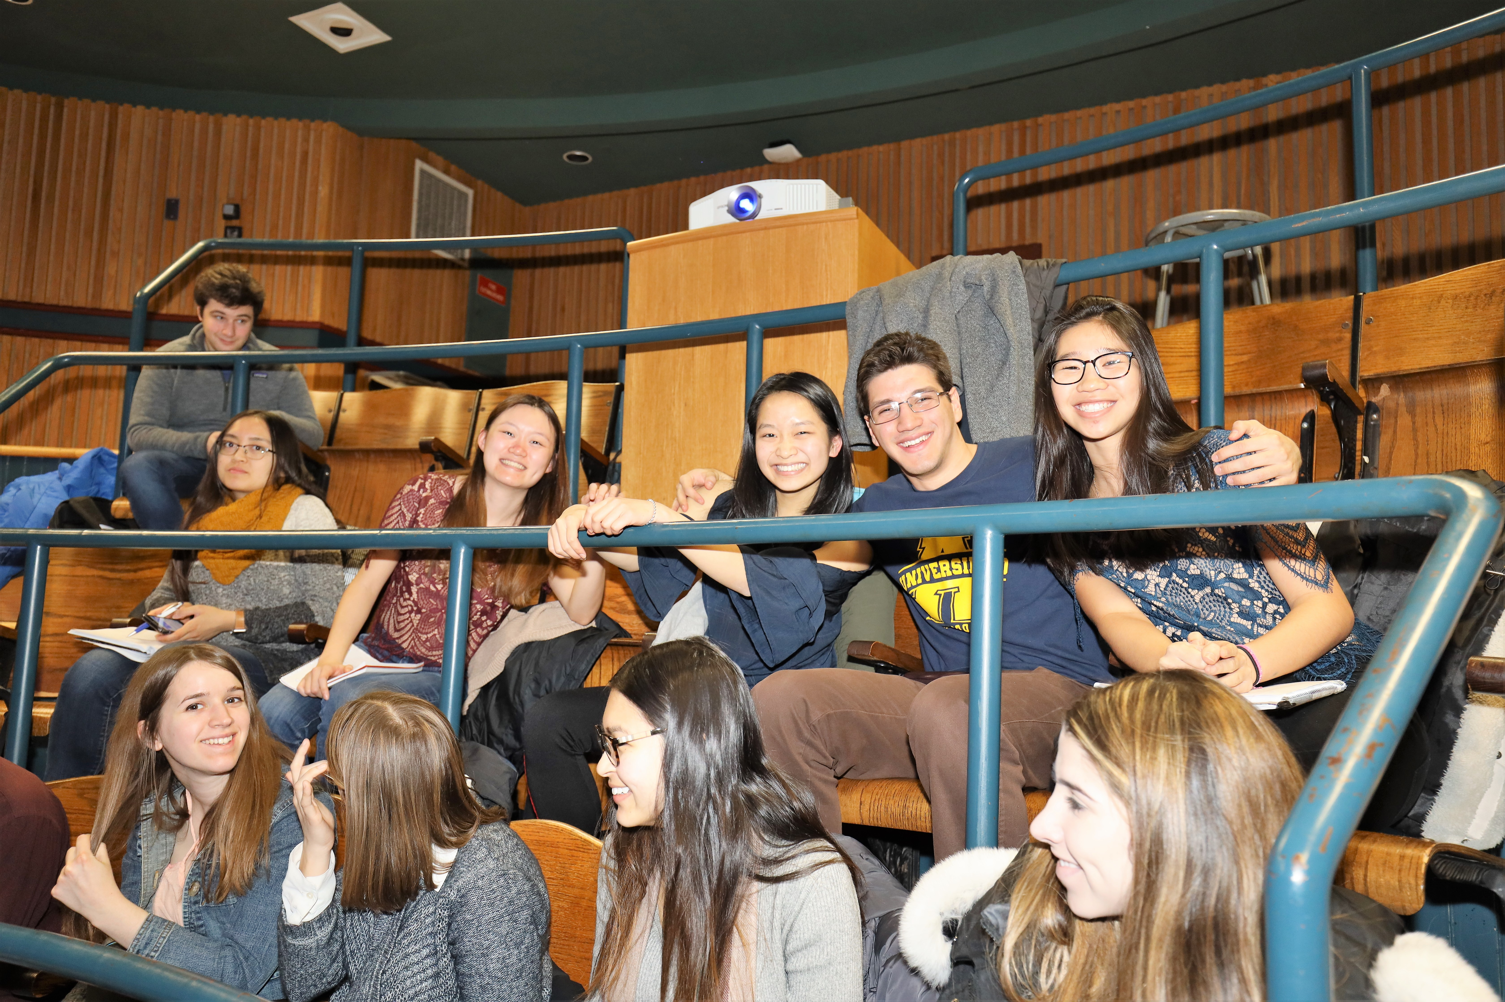
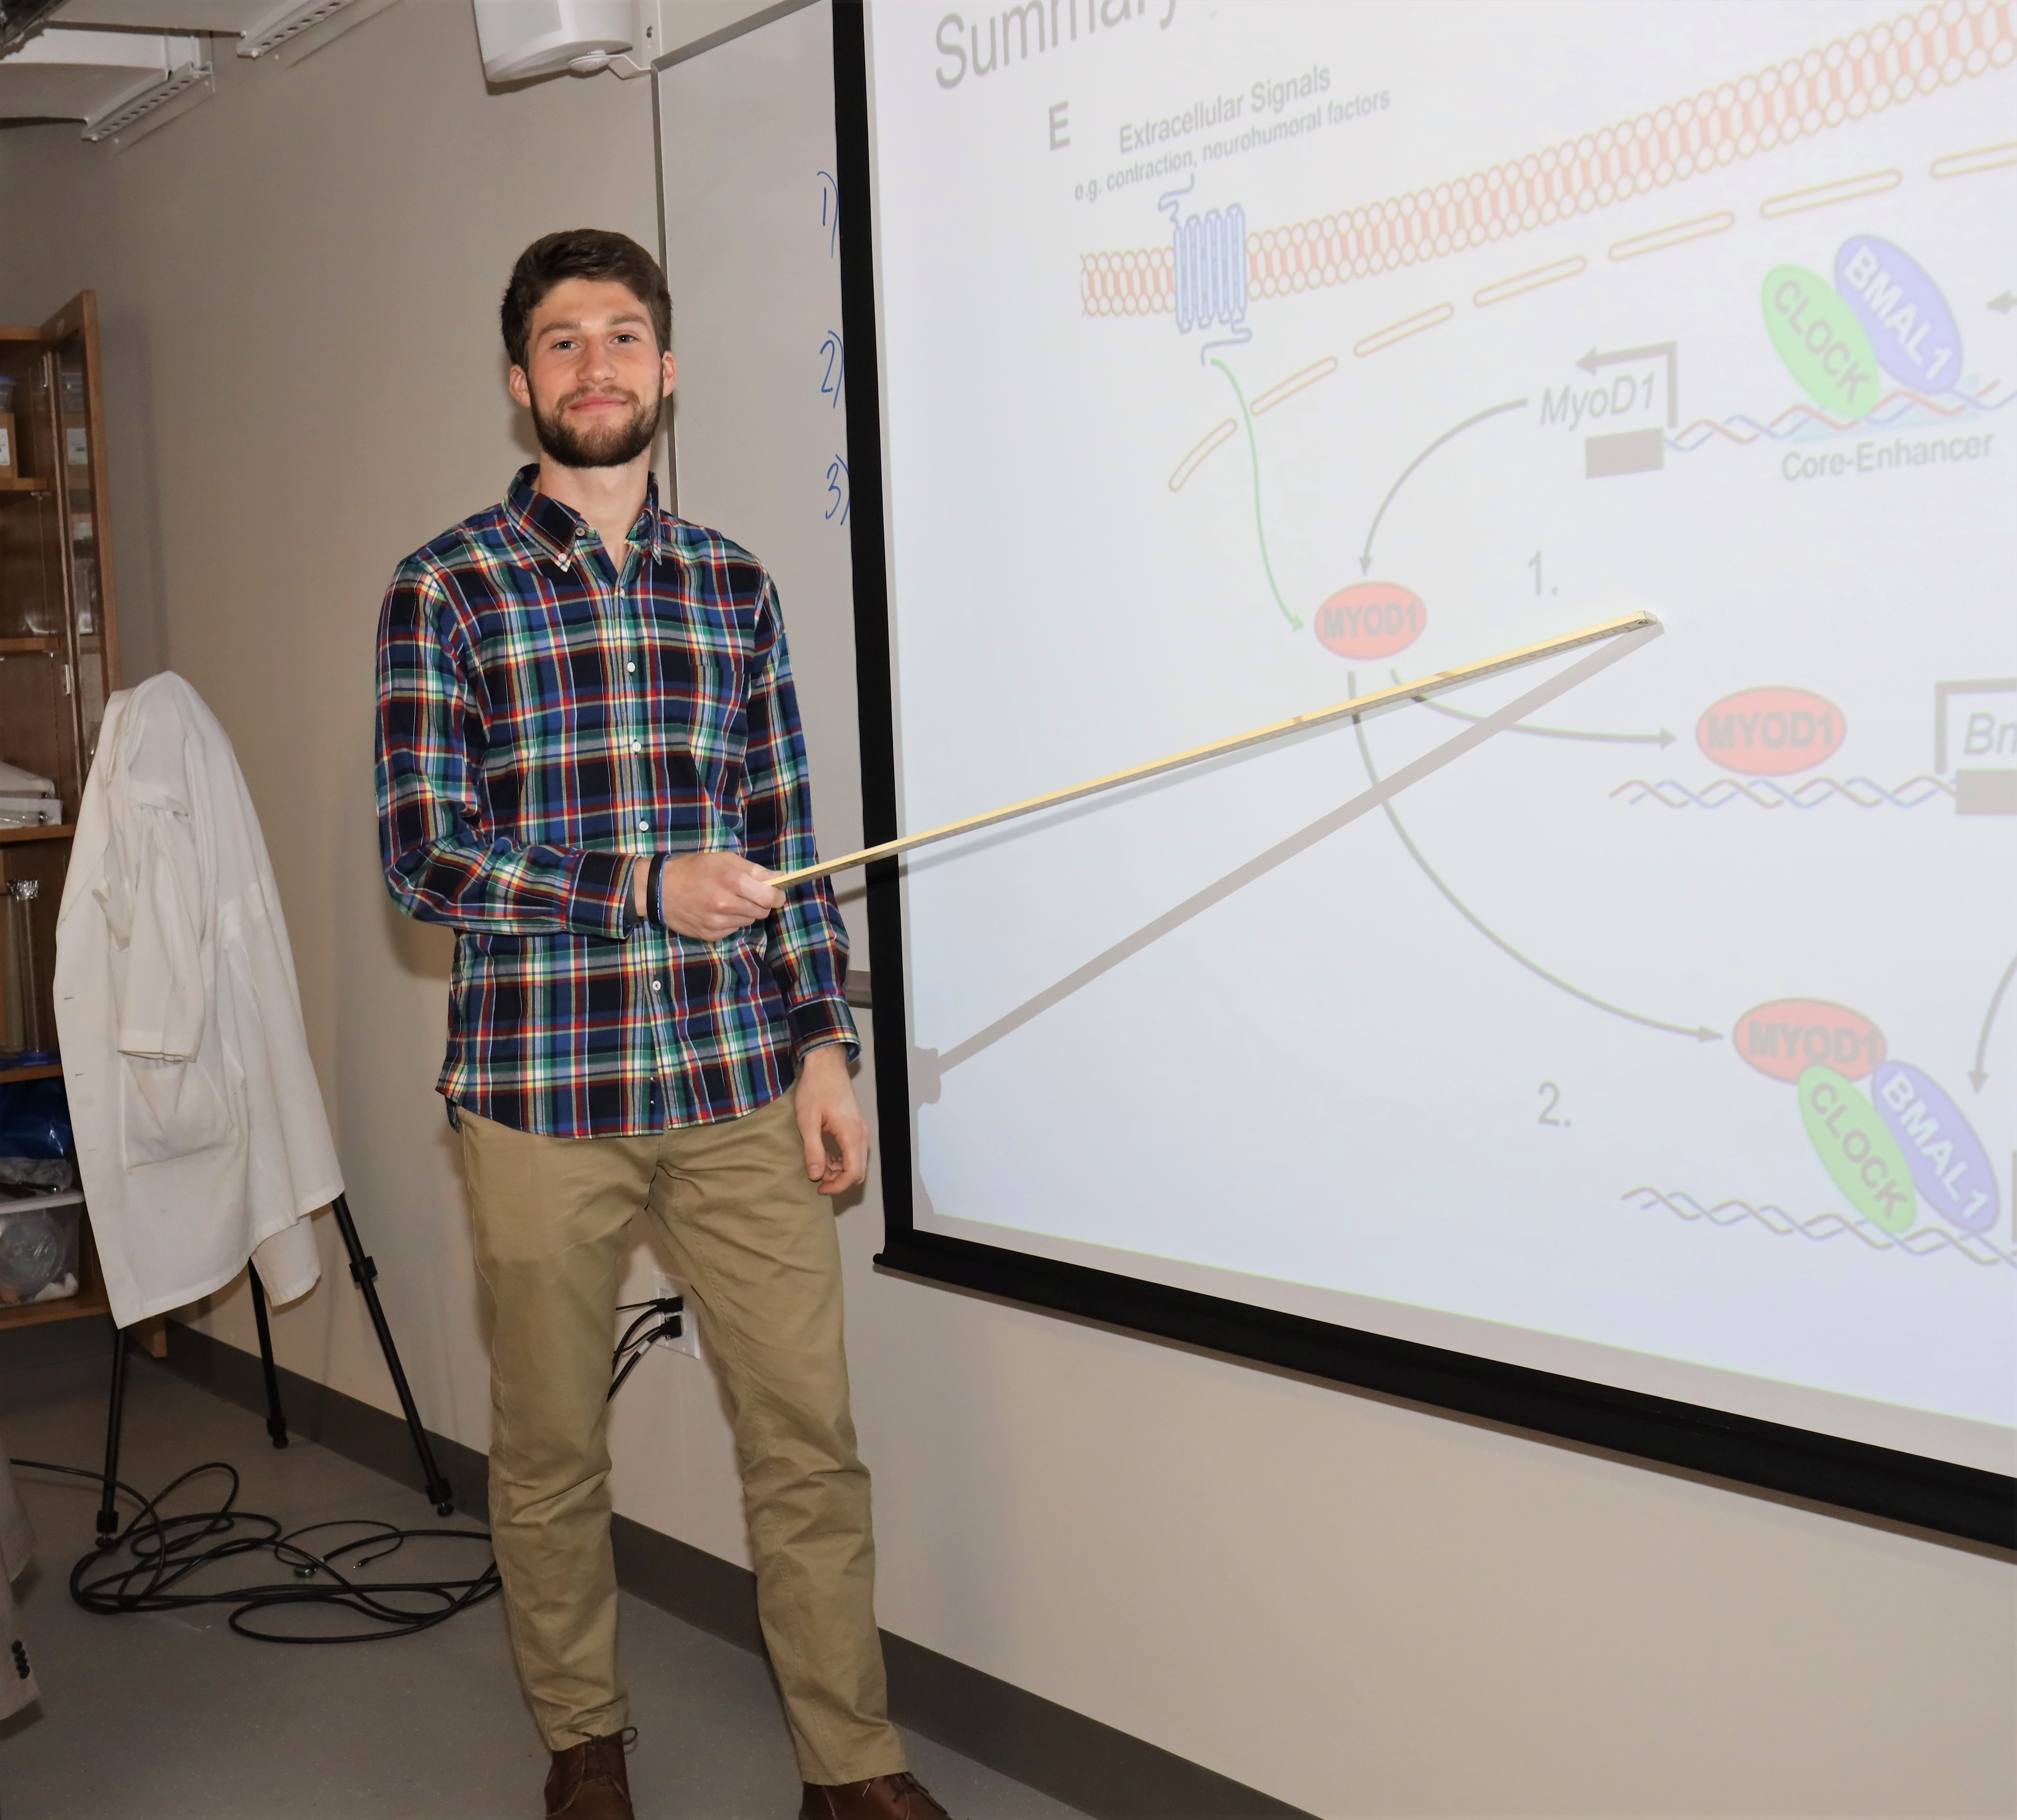
Alternative plan: choose a lab recommended by friend or advisor.

Slide 17

Possible paths
1. Start research as a junior or earlier (MCDB 475)– continue in same lab during senior year (MCDB 485/486 or 495/496).
2. Start research in summer following junior year- continue in same lab as senior.
3. Start research as a senior. Common, but not ideal.

Slide 18
Can you switch labs?
Depends.
Yes: if you switch prior to senior year, and stay in same lab for two consecutive terms (i.e., during senior year). If you do switch, choose a lab with similar research theme.
No: (exceptions are possible) if plan is to switch during senior year

Slide 19
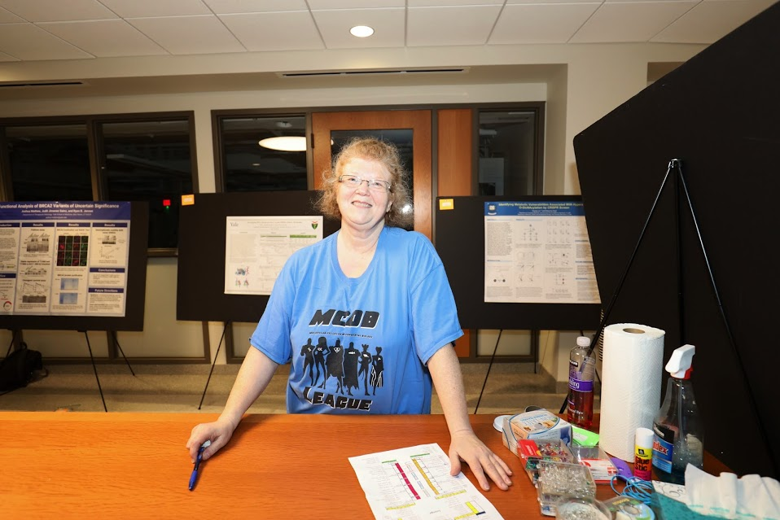
Crystal Adamchek crystal.adamchek@yale.edu
MCDB student Registrar KBT 1220B/YSB 231

Slide 20
10 Tips for Success
Get feedback from your mentor
  Be proactive in communicating with your mentor(s): PI and immediate mentor
  With mentor, set concrete and realistic expectations for research goals
  Periodically revisit those goals in meeting w mentor (e.g start Spring term)
  Ask for feedback on how you are doing, what you can do better

Slide 21
10 Tips for Success
Manage your time
  Plan ahead!
    Day-to-day planning
    Longer-term planning
  Experiments need careful planning
    Especially if your lab schedule/hours are limited
Be prepared
  Thoroughly familiarize yourself with techniques/protocols
  Read the background literature

Slide 22
10 Tips for Success
4) Lab safety
  Identify needed training, protective equipment
  If you are unsure, ask
  Minimize working alone in the lab
5) Be reliable and responsible
  Establish clear expectations about when you will be in lab
  Follow through on your commitments and communicate about problems
  Try to attend lab meeting if possible
  Take notes during meetings and training sessions
  Be respectful of your PI/mentor’s time

Slide 23
10 Tips for Success
6) Keep a detailed lab notebook
  Start writing before the experiment
  Analyzing the data is at least as important as doing the experiment
7) Approaching the end of the semester/year
  After the fall term, get feedback from your PI
    Ask what grade you might expect to receive based on performance to date
  Plan ahead for final report, poster and talk
8) Try to work as independently as you can
9) Failure is part of science
10) HAVE FUN!

Slide 24
Bonus tips for non-seniors
1) You can do research for credit before your senior year
  MCDB 474
2) You may be able to get paid to do research at Yale
  Term + summer: STARS II program (juniors only)
  Term: Student employment (with 50/50 Provost’s Office split)
    For students on financial aid, Yale can chip in half of your pay (alongside your PI)
  Summer:
    Fellowships (Dean’s Fellowship, Rosenfeld Scholars, awards from Colleges)
    Domestic Summer Award for students receiving financial aid

Slide 25
How to pick a research question: the Pasteur's Quadrant
Fundamental understanding
Niels Bohr
Pasteur
Usefulness
Thomas Edison

Slide 26
More comments
Fundamental versus applied: not a linear road
Understanding questions that have already been asked
Learn how to frame questions so that you can increase your understanding of the observed phenomena
Ask questions that can lead to more questions
Dialogues with colleagues
During your research:
Curiosity
Careful observations
Perseverance
Serendipity

Slide 27
Franklin’s oil experiment
Clapham pond, south London
Can you do better?
Size of a molecule!
Half an acre = 2420 yd² = 2420 x 0.9144² m²
One teaspoonful, say 2 cm³ = 2 x 10⁻⁶ m³
Hence the thickness of the film when one teaspoonful covers one half acre is: (2 x 10⁻⁶)/(2420 x 0.9144²) = 9.9 x 10⁻¹⁰ m

Slide 28
About proposal writing
Background
  Give an overview of the research field/basics. (Explain acronyms!!!)
  What has been done by other?
  What has been done by the lab you are in?
  What goal do you want to achieve?
Specific aims
  Usually two
  What will you do to achieve your goal?
  Propose an alternative strategy
References
  4-10 references
  Reviews, key original papers, previous work in the lab

Slide 29
Advertisement
21
0 µm
https://yanbiofilmlab.yale.edu/ or email me: jing.yan@yale.edu

Slide 30
Making the most of the meeting with PI
Be prepared
Present a short summary of what you did
Summarize results with a few sketches and figures
Useful observations
Questions you have

Slide 31
MCDB Research Overview
DUS: Douglas.Kankel@yale.edu YSB 111
Research Coordinators:
    Joseph.Wolenski@yale.edu YSB C112
    David.Breslow@yale.edu YSB 216
    Jing.Yan@yale.edu YSB C144

